Slide 1
SQL Server Basics

Slide 2
SQL Server Database
Storage structure
Data Organization
Data types
SQL Commands
Wild Card Characters
WHERE and HAVING clause
SQL Constraints
Normalization
VIEWS
Functions and Stored Procedures
Difference between Functions and Stored Procedures
JOINS
UNION and UNION ALL
CASE Statements
Exception handling

Slide 3
SQL server Databases
Two types of databases are there in SQL server
System database
Some pre-built databases
User database
User created databases

Slide 4
System Databases
Master : The default selected database after logging in. This database keeps an eye on the system. It records information about other databases in the system, Disk space, Usage, DBMS configuration. It represents the system schema.
Model : A database template. When a database is created in SQL server, the model database is inherited. So, if anything is changed in the model database, the newly created databases will get those changes.
TempDb : Stores all the temporary data from start to end of the SQL server instance that are used by the other databases. This database also inherits the model database.
Msdb : Used by the SQL server notification and agent service.

Slide 5
SQL server storage structure
Followings are the units of storage
Structure in SQL server
Database Files
Extents
Pages

Slide 6
Database Files
A database is comprised of three
kinds of files
.mdf file : Primary data file. Contains data
.ndf file : Secondary or other data files. Optional, contains Data.
.ldf file : Transaction log file, one or many. Contains transaction logs

Slide 7
Pages and Extents
SQL Server has two main types of
storage structures:
Extents
Page
All type of database objects are stored in
the data files (mdf and ndf files), which
spans across the Pages and Extents in the
data files

Slide 8
Data organization
Data in the tables in SQL server are organized in two
ways:
Heap:
When a table is created without any index, and, data is stored in the table, the table is said to be in a Heap.
The data rows are not stored in any particular order, and there is no particular order to the sequence of the data pages. Any data retrieval from the table in heaps results in a full scan of the table.

Slide 9
Data organization : Continued
Indexed table:
If a table as a clustered index (Primary key), then, the
table is said to be an indexed table.
The data rows and data pages are physically stored in the order based on the clustered Index key
Indexes are represented in the system using B+ Tree
(Balanced tree) . Indexes are preserved in Memory for faster access. Indexes are represented in tree structure (Using doubly linked list) for faster accesses of the index keys.

Slide 10
Types of Indexes
Two types of indexes are there
Clustered :
Creation of a primary key on a table results in creating a clustered index on the table.
Each tree node in the balanced tree of a Clustered index contains the actual row (Page).
Rows and (Pages) are physically sorted according to the clustered key.
There could be only one clustered index per table.

Slide 11
Types of indexes : Continued
Non Clustered :
Typically, creation of a Unique constraint results in creating a non-clustered index on the table.
The pointer could be a pointer to the clustered index
key, or, could be a pointer to the actual row (Page).
There could be at most 255 Non clustered indexes per table.

Slide 12
Data types
Data types in SQL Server are organized into the following categories:
Exact numerics –> smallint, int, bigint…
Approximate numerics -> float, real
Date and time -> date, time, datetime…
Character strings -> char, varchar, text…
Unicode character strings -> nchar, nvarchar, ntext…
Binary strings -> binary, nbinary, image
Other data types -> xml, table…

Slide 13
SQL Commands
DML
DML is abbreviation of Data Manipulation Language. It is used to retrieve, store, modify, delete, insert and update data in database.
SELECT – Retrieves data from a table INSERT – Inserts data into a table UPDATE – Updates existing data into a table DELETE – Deletes all records from a table
DDL
DDL is abbreviation of Data Definition Language. It is used to create and modify the structure of database objects in database.
CREATE – Creates objects in the database ALTER – Alters objects of the database DROP – Deletes objects of the database TRUNCATE – Deletes all records from a table and resets table identity to initial value.
DCL
DCL is abbreviation of Data Control Language. It is used to create roles, permissions, and referential integrity as well it is used to control access to database by securing it.
GRANT – Gives user’s access privileges to database REVOKE – Withdraws user’s access privileges to database given with the GRANT command
TCL
TCL is abbreviation of Transactional Control Language. It is used to manage different transactions occurring within a database.
COMMIT – Saves work done in transactions ROLLBACK – Restores database to original state since the last COMMIT command in transactions SAVE TRANSACTION – Sets a savepoint within a transaction

Slide 14
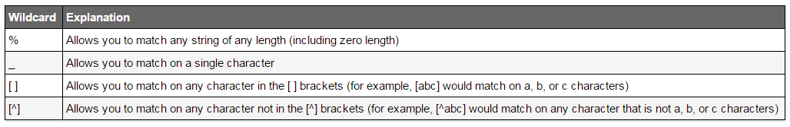
Wild Card Characters
Wildcard characters are used in the where clause to search a string with some patterns.

Slide 15
WHERE and HAVING clause
WHERE
Restricts the rows returned in the result set through the use of predicates. There is no limit to the number of predicates, separated by an AND clause, that can be included in a search condition.
HAVING
Specifies a search condition for a group or an aggregate. HAVING can be used only with the SELECT statement. HAVING is typically used in a GROUP BY clause. When GROUP BY is not used, HAVING behaves like a WHERE clause.

Slide 16
SQL Constraint
Primary Key Constraint
Primary Keys constraints prevents duplicate values for columns and provides unique identifier to each column, and it creates clustered index on the columns.
Foreign Key Constraint
When a FOREIGN KEY constraint is added to an existing column or columns in the table SQL Server, by default checks the existing data in the columns to ensure that all values, except NULL, exist in the column(s) of the referenced PRIMARY KEY or UNIQUE constraint.
Unique Constraint
Unique constraints is similar to primary key constraint it prevents duplicate values for columns and provides unique identifier to each column, but it doesn’t create clustered index on the columns, and allows one null entry.
Default Constraint
Default constraint when created on some column will have the default data which is given in the constraint when no records or data is inserted in that column.
Notes:
http://blog.sqlauthority.com/2008/09/08/sql-server-%E2%80%93-2008-creating-primary-key-foreign-key-and-default-constraint/

Slide 17
Normalization
Normalization is a data base design technique that minimizes duplication of information, data redundancy and risk of errors. There are many forms of normalization
N1 :
Primary key must be there
Columns should be single valued
All column should depend on primary key
N2
It should be 1st NF
IF primary key is a composite of multiple columns, then non key columns must depend on whole key
N3
It should be 2nd NF
Table should be decomposed to reduce redundancy

Slide 18
Views
View are additional layer on the table which enables us to protect sensitive data based upon our needs. In other words we can say views are virtual tables which could be combination of multiple tables that also hides complex queries which we write to retrieve data.

Slide 19
Functions
Functions are very power full data base objects because it can be use in any sql queries where we would be using columns or tables for example in select statements , where clause, joins, constraints or even in other functions.
System defined functions
Scalar functions -> round, trim, uppercase, lowercase…
Aggregate functions -> max, min, avg, count…
User defined functions
Scalar functions
Inline table valued function
Multi statement table valued function
Stored Procedures
Stored procedures are precompiled queries, stored in Sql server data base, which we can call whenever we want .
Notes:
create table Employee(Id int identity(1,1) constraint pk_employee primary key, Name varchar(50), DeptId int)
alter table Employee add constraint fk_dept foreign key(DeptId) references Department(DeptId)
on delete cascade
alter table employee add constraint uk_name unique(name)
create table Department(DeptId int constraint pk_dept primary key, DeptName varchar(30))
--alter table Employee alter column Id int identity( 1 , 1)
insert into Department values(1, 'Development')
insert into Department values(2, 'Management')
insert into Department values(3, 'Sales')
set nocount on
insert into Employee values('Sanat', 1)
insert into Employee values('Sanjay', 2)
insert into Employee values('Sathwic', 2)
update Employee set name = 'Sathwic' where id = 4
delete from Employee where id = 7
set nocount on
select e.* from Employee AS e
select * from Department
delete from Department where DeptId = 2
select e.Id, e.Name, d.DeptName from Employee e
right outer join Department d
ON e.DeptId = d.DeptId where e.DeptId is null

Slide 20
Difference between Functions and Stored Proc
Functions | Stored Proc
Return is must | Not necessary
Can be used in sql statements any where | Can’t
Only select statement can be written inside function | Can do all DML operations
Can have only input parameters no out parameters | Can have out parameters as well
Transactions not allowed | Transaction is allowed
Try catch not allowed | Allowed
SP can’t be called in functions | Functions can be called inside SP
Can be called in joins | Can’t
Can be called in select statements | Can’t

Slide 21
Join
In order to combine the result of two or more tables we use joins in Sql server. It combines the results side by side. There are multiple types of joins
Left join
Right join
Inner join
Outer join

Slide 22
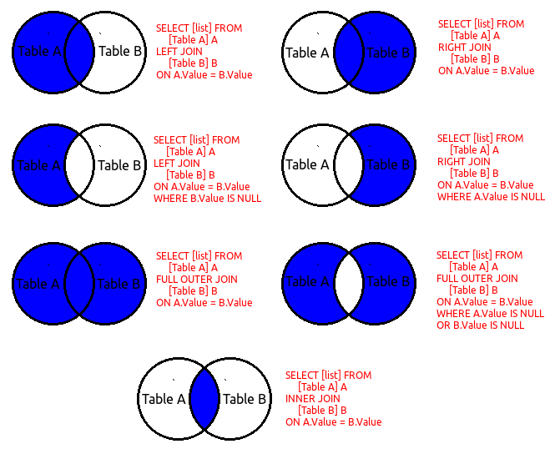

Slide 23
Union and Union All
UNION
The UNION command is used to select related information from two tables, much like the JOIN command. However, when using the UNION command all selected columns need to be of the same data type. With UNION, only distinct values are selected.
UNION ALL
The UNION ALL command is similar to the UNION command, except that it combines all values.
Notes:
CREATE TABLE TABLE1(Email varchar(30) , Name varchar(30), Phone int)
INSERT INTO TABLE1 VALUES('a@a.com','Sam',1111)
INSERT INTO TABLE1 VALUES('b@b.com','Saw',2222)
INSERT INTO TABLE1 VALUES('c@c.com','Man',3333)
INSERT INTO TABLE1 VALUES('d@d.com','Wan',4444)
CREATE TABLE TABLE2(Email varchar(30) , Name varchar(30), Phone int)
INSERT INTO TABLE2 VALUES('a@a.com','Sam',1111)
INSERT INTO TABLE2 VALUES('b@b.com','Saw',2222)
INSERT INTO TABLE2 VALUES('c@c.com','Man',7777)
INSERT INTO TABLE2 VALUES('d@d.com','Wan',8888)
SELECT * FROM TABLE1
SELECT * FROM TABLE2
SELECT * FROM TABLE1
UNION
SELECT * FROM TABLE2
SELECT * FROM TABLE1
UNION ALL
SELECT * FROM TABLE2

Slide 24
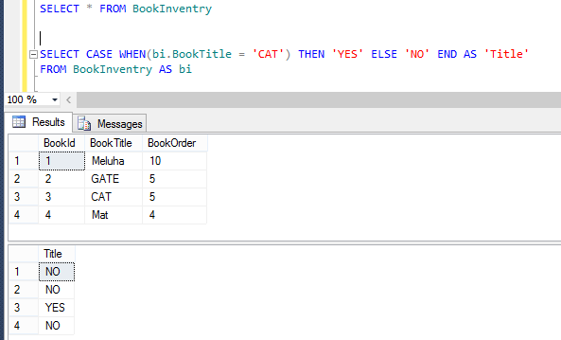
Case statement

Slide 25
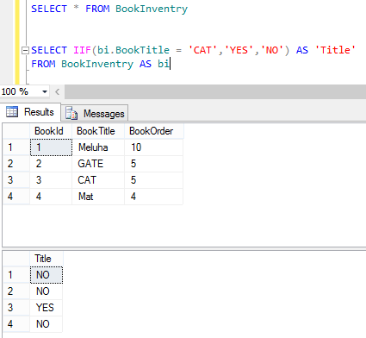
IIF

Slide 26
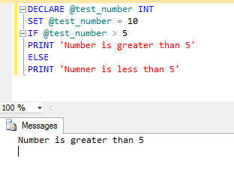
If - Else

Slide 27
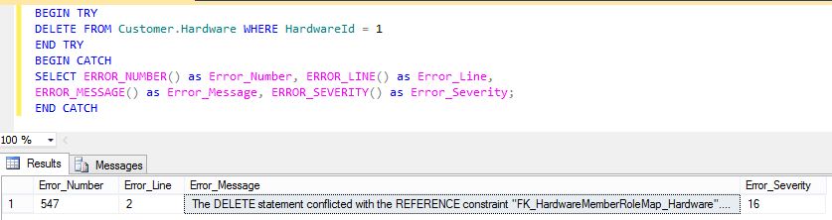
Exception handling
Sql server provides exception handling feature as well, we can use try catch if query is proven to throw exceptions. Or we can use it if we want to see proper error messages.
Example:

Slide 28
Thank you

